Slide 1
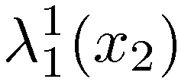
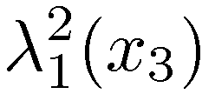
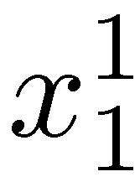
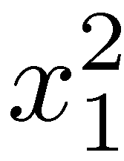
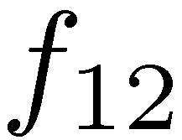
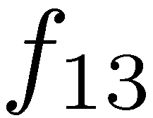
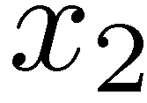
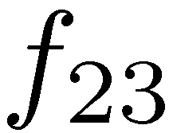
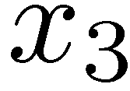
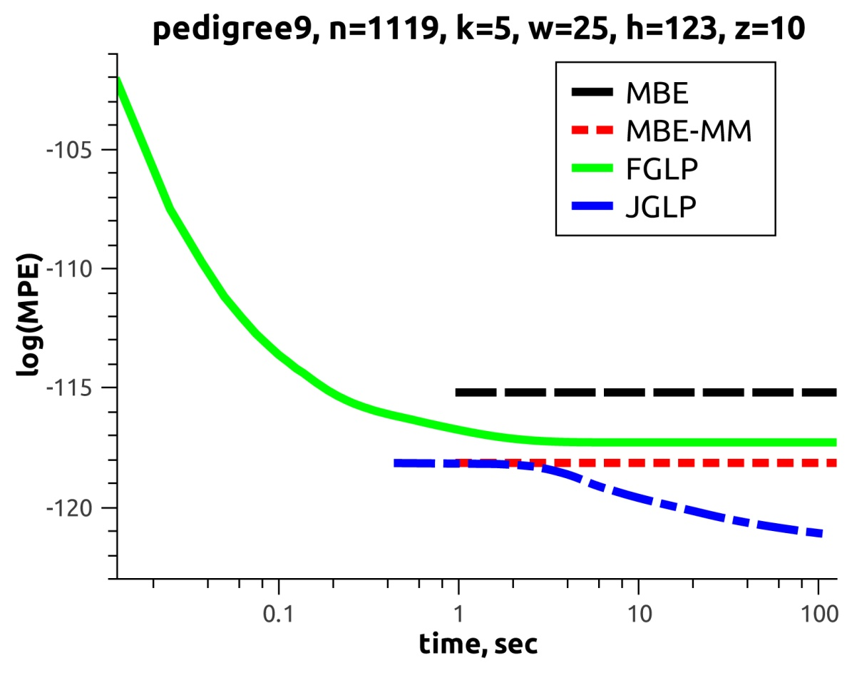
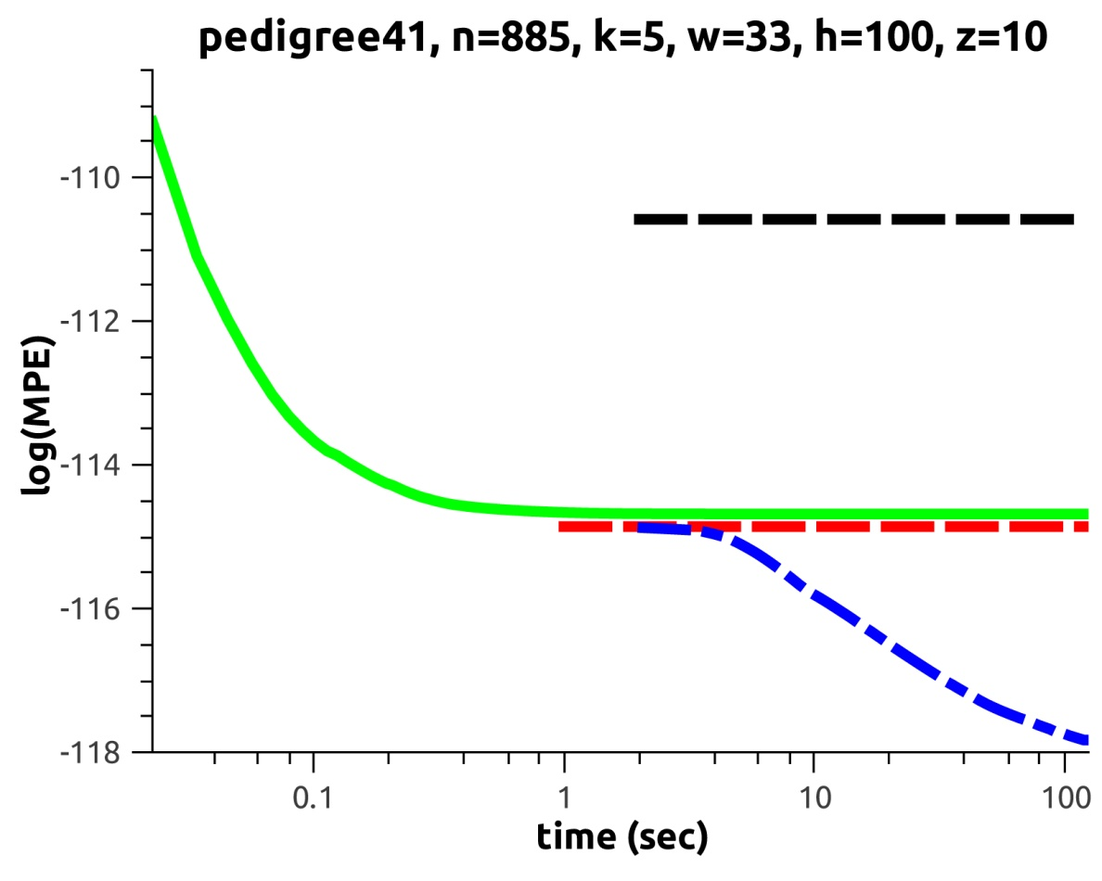
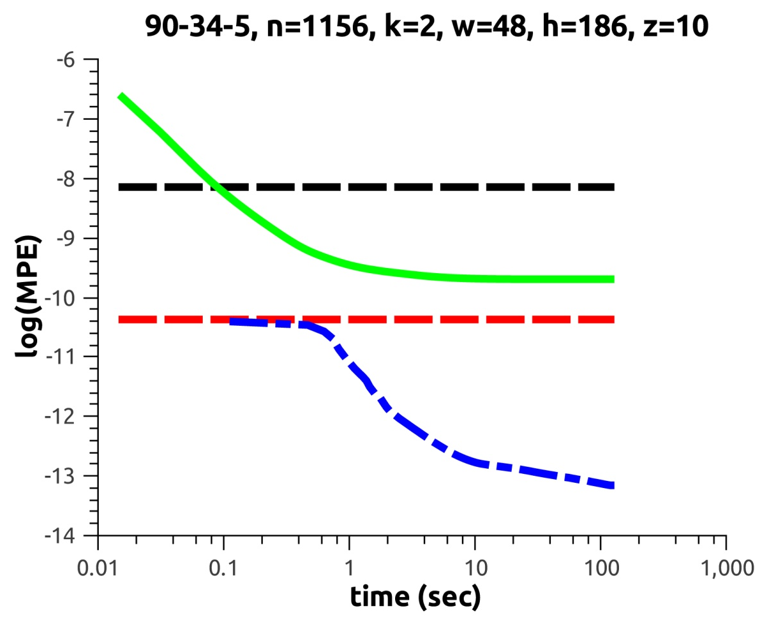
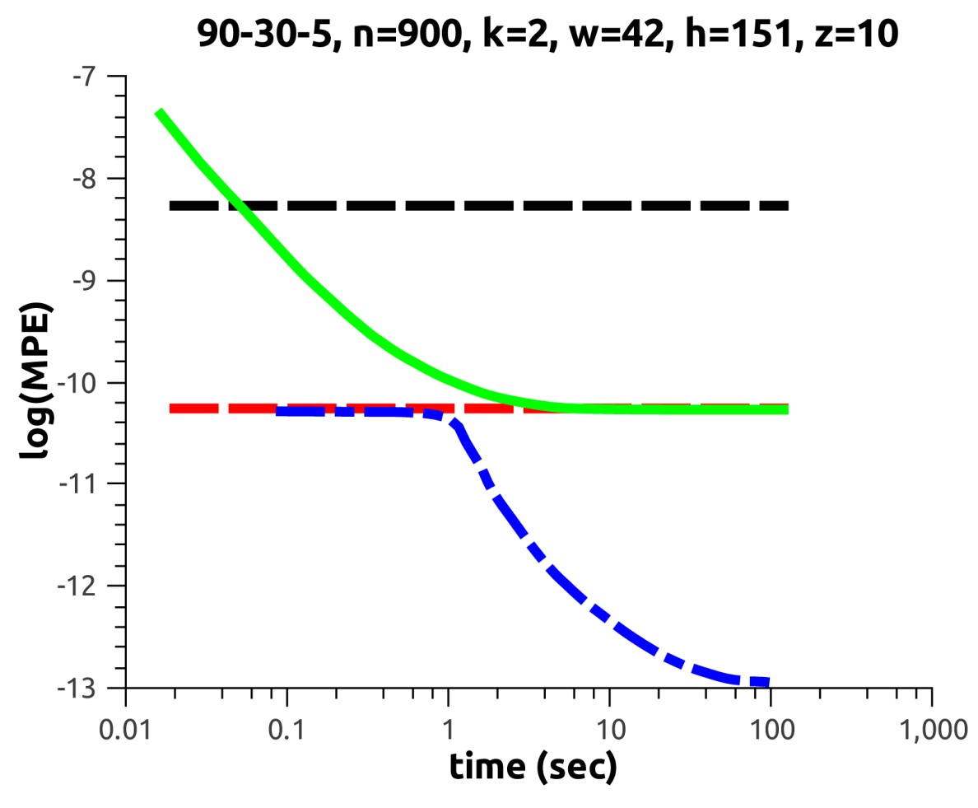
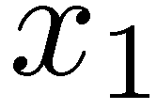
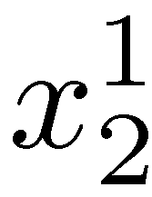
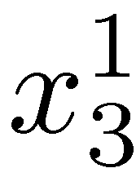
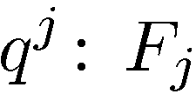
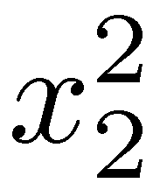
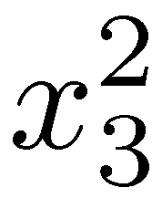
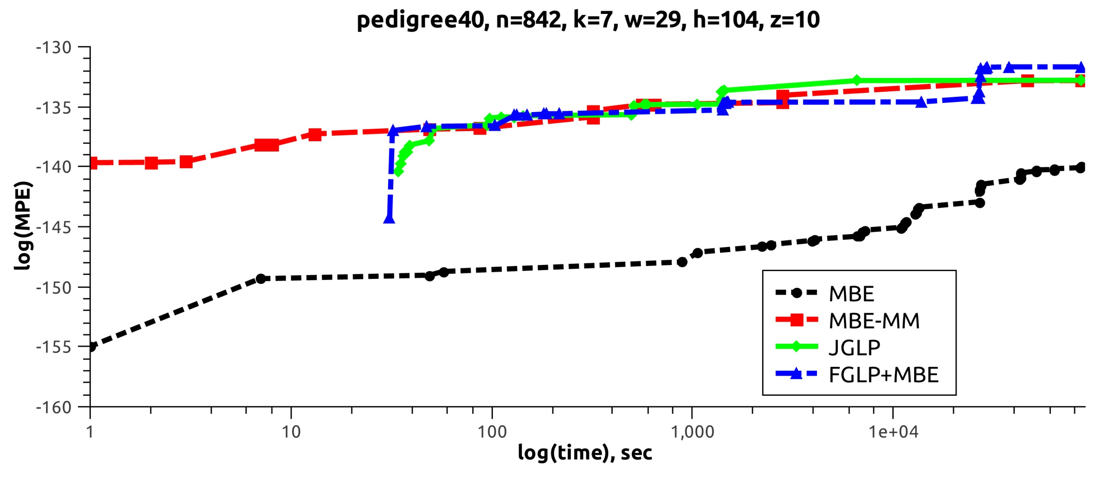
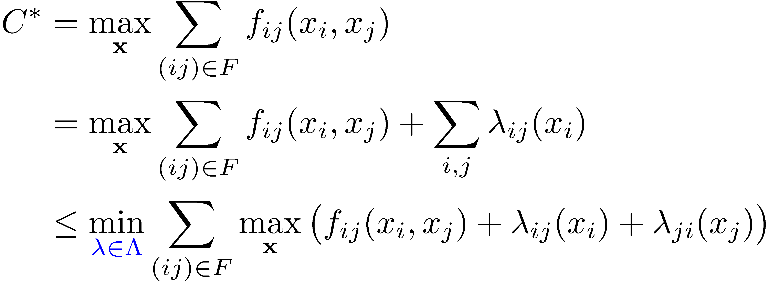
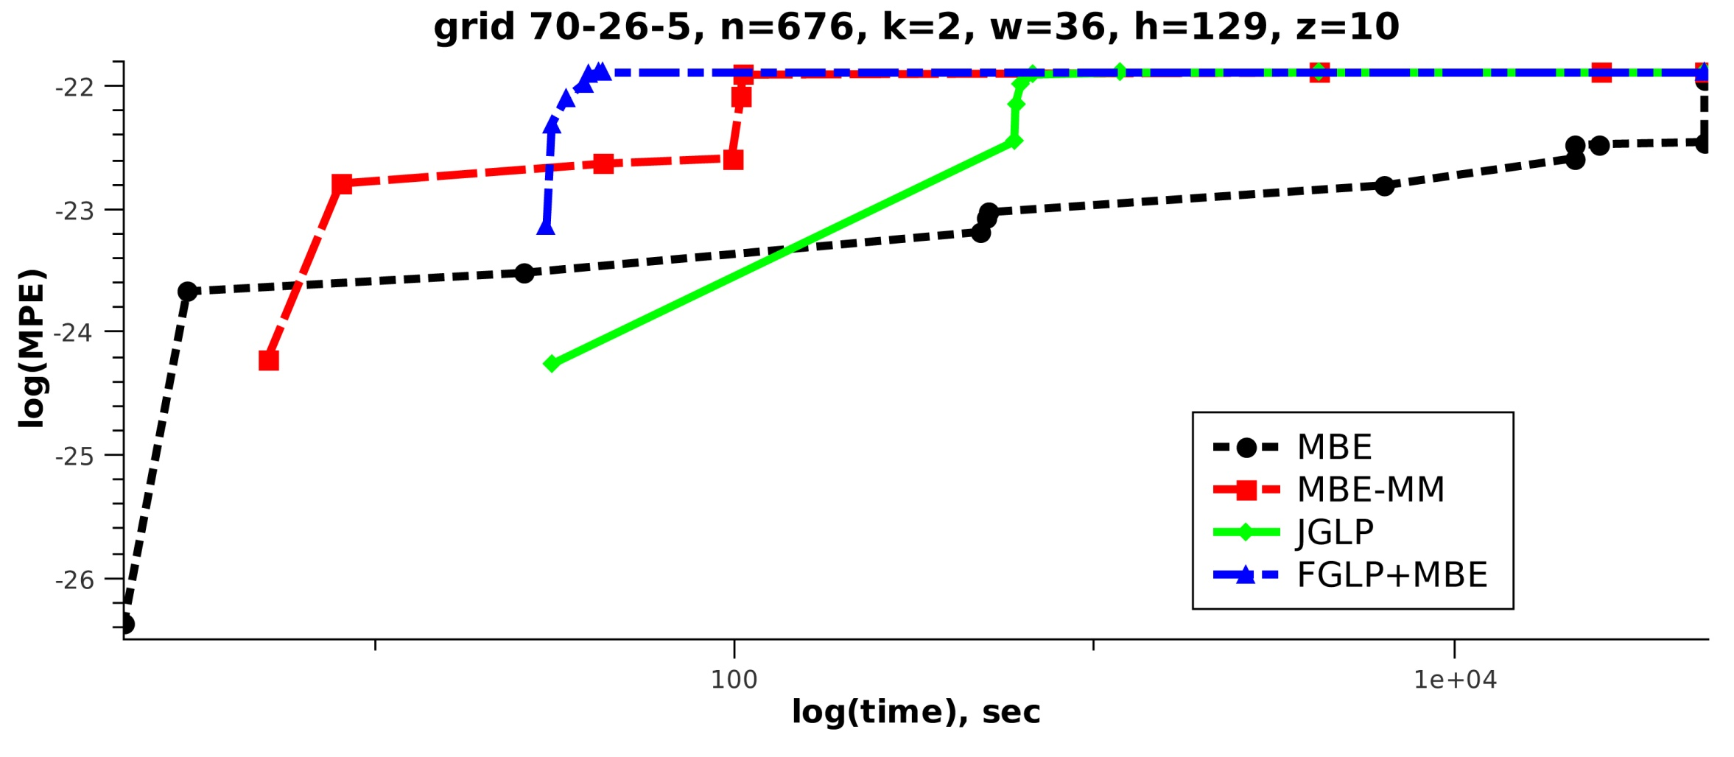
Join-graph based cost-shifting
Alexander Ihler, Natalia Flerova, Rina Dechter and Lars Otten
University of California Irvine
Introduction
Mini-Bucket Elimination
Pascal MPE tasks
Our task:
Finding approximate solutions to combinatorial optimization problems defined over graphical models (e.g. MAP).
Our contribution:
Combine two well-known approaches:
Mini-Bucket Elimination [Dechter & Rish, 2003]
Linear Programming [Wainwright et al., 2005; Globerson & Jaakkola, 2007; Sontag et al., 2010 etc.]
yielding new hybrid schemes:
Mini-Bucket Elimination with Moment-Matching
Join Graph Linear Programming
Given input parameter z and variable ordering o:
based on their scopes, functions are partitioned into “buckets”, associated with variables
buckets are processed according to o and those that have more than z variables are split into “mini-buckets”
B1:
B2:
B3:
First-place solver in all three MPE time limits
Factor graph LP reparameterization (to tolerance or time)
Local search procedure
Build join-graph with bound z/2
Join graph LP reparameterization (to tolerance or time)
Build join-graph with bound z (= memory limit)
Mini-bucket with max-marginal matching
AND/OR Branch & Bound Search with Caching
Can be interpreted using a junction tree view:
Can also be interpreted as exact Bucket Elimination on a relaxed problem with duplicated variables:
B2
Experiments
Mini-Bucket Elimination:
single-pass algorithm
problem relaxed by duplicating some variables
typically operates on large clusters (“top down”)
Linear Programming:
iterative scheme
problem relaxed by splitting into independent components
typically operates on original functions (“bottom up”)
B3
4 benchmarks:
pedigrees
type4
LargeFam
n-by-n grid networks
+
genetic linkage analysis networks
Fixed-point updates
Join Graph
Linear Programming
MBE with
Moment-Matching
Can use any decomposition updates
(message passing, subgradient, augmented, etc.)
Study two example forms:
Update the original factors (FGLP):
Tighten all factors over x_{i} simultaneously
Compute max-marginals
& update:
Update clique functions of the join graph (JGLP)
Use MBE to generate the join graph
Define function F_{i} for each clique (mini-bucket) q^{i}
Update each edge over separator set
Iterative tightening as bounding schemes
4 bounds: MBE, MBE-MM, FGLP, JGLP
Decomposition bounds
Original problem
Upper bound
max(f₁₂+f₁₃+f₂₃)
max f₁₂+max f₁₃+max f₂₃
MBE with Moment-Matching
Iterative tightening in search guiding heuristics
Anytime AND/OR Branch and Bound produces lower bounds on the optimal solution, until the exact solution is found.
4 heuristics: MBE, MBE-MM, FGLP+MBE, JGLP.
MBE-MM is closely related to MBE with bucket propagation (Rollon & Larrosa 2006), but:
MBE-MM corresponds to a partial execution of a global optimization
Bucket propagation update is heuristic and cannot be further iterated
Maximize each factor independently, subject to
single-pass algorithm, processing
mini-buckets top down along ordering
Messages only within each bucket
Easy to gauge memory & time use
Corresponds to ½ iteration of JGLP
Introduce functions for each edge (ij)
- “reparametrization” or “cost shifting”
B2
B3
Bound the optimal configuration value:
Dual decomposition, soft arc consistency, max-product linear programming, max-sum diffusion, etc.
Optimum equals a linear programming relaxation
Can use various update methods to tighten the bound
Summary of experiments
reparametrization
MBE-MM always improves upon MBE, using comparable time and memory
FGLP converges quickly and consumes less memory than the other schemes
Given sufficient time and memory JGLP produces the tightest bound

