Slide 1

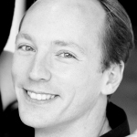
Anytime Anyspace AND/OR Best-first Search for Bounding Marginal MAP
Presenter: Qi Lou
Joint work with Rina Dechter and Alex Ihler

Slide 2
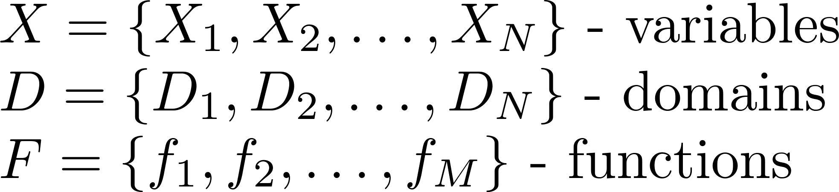
Graphical Models
A graphical model (X, D, F):
Bayesian networks, Markov random fields (MRF), factor graphs, etc.
  Example model (MRF):
(we’ll assume discrete)
A
B
A | B | f(A,B)
0 | 0 | 0.24
0 | 1 | 0.56
1 | 0 | 1.2
1 | 1 | 1.2
B | C | f(B,C)
0 | 0 | 0.12
0 | 1 | 0.36
1 | 0 | 0.3
1 | 1 | 1.7
…
C
Notes:
As we know, a graphical model is a collection of variables, domains and non-negative functions. Models can be either discrete or continuous. In this work, we focus on discrete models only. There’re many types of graphical models, such as Bayesian networks, Markov random fields, and factor graphs. [click] For example, this is a pairwise model of three variables. On the right is a graph representation of this model. There is an edge between two variables if they are in the scope of some function. Usually, we use tables to represent functions.

Slide 3
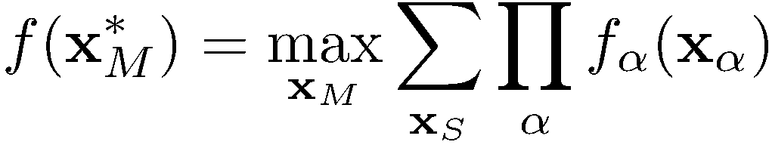
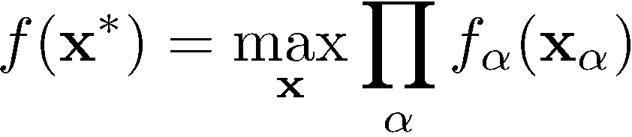
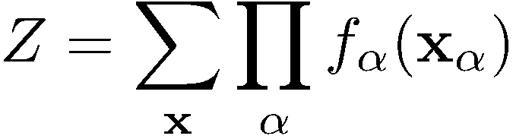
Marginal MAP (MMAP)
Mixed inference (marginal MAP, MEU, …)
  Generalizes two other tasks:
    MAP:
    Partition function:
Test
cost
Drill
cost
Oil
sales
Test
Influence diagrams &
optimal decision-making
(the “oil wildcatter” problem)
Test
result
Drill
Oil
produced
Oil sale
policy
e.g., [Raiffa 1968; Shachter 1986]
Seismic
structure
Oil
underground
Sales
cost
Market
information
Notes:
Graphical models are widely used in many domains such as decision-making problems.
(CLICK) A typical query in those applications can be formulated as to find the maximum configuration of a set of variables with the rest variables being marginalized. We call this task marginal map.
(CLICK) this task generalizes both the maximization and summation tasks, and is the task we are focusing on today.
(CLICK) It’s well-known that marginal map is very challenging and is intractable even for tree-structured models. So, we usually resort to approximations.

Slide 4
Bounding Marginal MAP
Variational bounds
  e.g., approximate elimination methods [Liu & Ihler 2011; Dechter & Rish 2003; Ping et al., 2015]
Monte Carlo methods
  e.g., random hashing based [Xue et al. 2016]
Search algorithms
  e.g., heuristic search on AND/OR search spaces [Marinescu et al., 2017; 2015; 2014; Lee et al., 2016]
Variational bounds
Reason over small subsets of variables at a time
Monte Carlo Methods
Use randomization to estimate averages over the state space
Search algorithms
Structured enumeration over all possible states
A
0
1
B
0
1
0
1
E
0
1
0
1
0
1
0
1
C
0
1
0
1
0
1
0
1
0
1
0
1
0
1
0
1
D
0
1
0
1
0
1
0
1
0
1
0
1
0
1
0
1
0
1
0
1
0
1
0
1
0
1
0
1
0
1
0
1
F
0
1
0
1
0
1
0
1
0
1
0
1
0
1
0
1
0
1
0
1
0
1
0
1
0
1
0
1
0
1
0
1
0
1
0
1
0
1
0
1
0
1
0
1
0
1
0
1
0
1
0
1
0
1
0
1
0
1
0
1
0
1
0
1
Notes:
Among those approximate schemes, those with deterministic or probabilistic guarantees are of particular interest because they quantify the bounds on the approximation errors.
(CLICK) There are three major paradigms for bounding marginal MAP, that is, variational bounds, Monte Carlo methods, and search algorithms. They have their own pros and cons. Our work lies in the third paradigm.

Slide 5
Our Contributions
Propose a “pure” best-first search algorithm that provides anytime upper bounds for Marginal MAP
  Focuses on reducing the upper bound as quickly as possible
  Unifies max- and sum- inference in one search framework
    avoids some unnecessary exact evaluation of conditional summation problems
  Operates within limited memory
  Shows strong empirical performance
Notes:
In this work, we propose a best-first search algorithm that provides anytime upper bounds for marginal MAP.
(CLICK) It focuses on upper bound and tries to reduce upper bound as quickly as possible.
(CLICK) Our framework unifies max- and sum- inference, and avoids some unnecessary exact evaluation of conditional summation problems, which is often a bottleneck of the previous search algorithms.
(CLICK) Our algorithm also operates within the limited memory setting, and shows also strong empirical performance as you will see later.

Slide 6
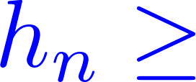

AND/OR Search Trees
A
[Nillson 1980;
Dechter & Mateescu 2007]
F
-- MAX variable
B
G
A
B
E
C
F
-- SUM variable
OR
D
C
D
E
G
A
primal graph
pseudo tree
AND
[Freuder and Quinn 1985]
0
1
OR
n
B
B
AND
0
1
0
1
OR
C
C
C
C
F
F
F
F
AND
0
1
0
1
0
1
0
1
0
1
0
1
0
1
0
1
OR
E
D
E
D
E
D
E
D
E
D
E
D
E
D
E
D
G
G
G
G
G
G
G
G
AND
0
1
0
1
0
1
0
1
0
1
0
1
0
1
0
1
0
1
0
1
0
1
0
1
0
1
0
1
0
1
0
1
1
0
1
1
1
1
1
1
0
0
0
0
0
0
1
0
Notes:
To be clear, we perform our search on an AND/OR search tree of the corresponding graphical model because it can capture some conditional independence in graphical models. For example, if we condition two variables A, B, we now have two sets of variables that are mutually independent, which can be reflected in the AND/OR search tree here.
(CLICK) At each node, there is an associated quantity called value of this node, which is the inference task value of the sub-problem underneath this node. (CLICK) We also have a pre-compiled heuristic that bounds this value. (CLICK) Some previous search algorithms only apply to the search space involving only MAX variables (CLICK) while we integrate MAX and SUM in one search space.

Slide 7
A Unified Best-first Search Algorithm
Track the current most promising (partial) MAP configuration
  Determines the current global upper bound
Expand the most “influential” frontier node (can be either MAX or SUM node) of that (partial) MAP configuration
  Captured by a specially designed “double-priority” system
Notes:
Now let’s dive into the main idea of our algorithm.
(CLICK) Generally, our algorithm keeps track of the current most promising partial MAP configuration, that is, the one with the highest upper bound. It actually determines the current global upper bound.
(CLICK) Our algorithm expands the most “influential” frontier node to the MAP solution, the frontier node that contributes most to the upper bound of that MAP configuration, which can be captured by a specially designed “double-priority” system. The detailed construction of this priority system can be found in the paper.

Slide 8
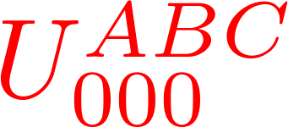
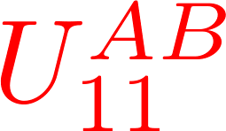
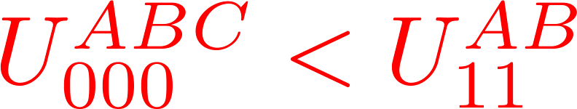
A Unified Best-first Search Algorithm
-- MAX variable
-- SUM variable
A
A
0
1
0
1
B
B
B
B
0
1
0
1
0
1
0
1
C
F
C
F
0
1
0
1
0
1
0
1
G
G
0
1
0
1
Notes:
Let me show you a simple example to illustrate the idea. Suppose this is our current search. Our algorithm keeps track the most promising MAP configuration. (CLICK) Let’s say this is our current best partial MAP configuration (CLICK) there are three frontier nodes related to the this partial MAP configuration and we will expand the one that contributes most to the partial MAP configuration in the next expansion. Now suppose this SUM node is the one it decides to expand (CLICK). Not like previous search methods, we will not solve the conditional summation problem immediately, because after one expansion, the most promising partial MAP configuration might change (CLICK). Thus, we should put our effort on this new partial MAP configuration and will revisit this internal summation problem only when necessary. This strategy can possibly save a lot of computational time.

Slide 9
A Unified Best-first Search Algorithm
Memory-limited version
  SMA*[Russell 1992] - like:
    Keep track of the least promising partial MAP configuration
    Remove its least “influential” frontier node when approaching the memory limit
Notes:
Our algorithm also runs with limited memory. It takes a SMA*-like strategy by keeping track of the least promising partial MAP configuration and removing its least “influential” frontier node when necessary.

Slide 10
Empirical Evaluation
Baselines:
  AAOBF [Marinescu et al. 2017]; XOR_MMAP [Xue et al. 2016]; AFSE [Maua & deCampos 2012]
Benchmarks:
  grid: 100 grid networks; promedas: 100 medical diagnosis expert systems; protein: 50 made from the “small” protein side-chains of [Yanover & Weiss 2002]
  Randomly select 50% (or 10%) variables as MAX variables
Memory & runtime:
  4GB & 1hr
Notes:
We compare our algorithms to the state-of-the-art search algorithm AAOBF. AAOBF performs best-first search in the MAP space; when it encounters a summation problem, it solves it immediately using depth-first search. a recent random hashing based approach XOR MMAP, a factor-set elimination scheme AFSE. AAOBF and AFSE can provide anytime deterministic bounds, while XOR MMAP provides anytime stochastic bounds. They are selected to represent different types of methods.
(CLICK) Three benchmarks are formed by instances from recent UAI competitions. A portion of variables are randomly assigned as MAX variables.
(CLICK) The memory and runtime are set to be 4GB and one hour respectively

Slide 11
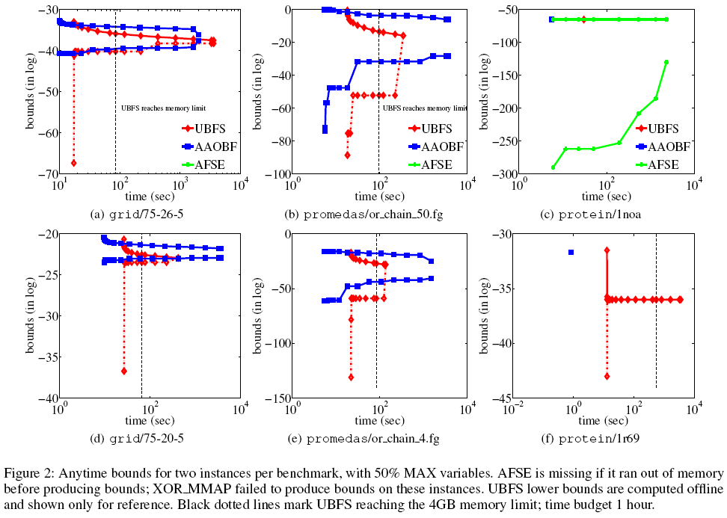
Notes:
These plots show the anytime behavior of our algorithm compared with baselines two instance per benchmark.
(CLICK) let’s take this plot for example. You can see that our UBFS algorithm provides more accurate upper bounds. The bounds keep improving even it reaches the memory limit (dotted line). Our algorithm can also provide anytime MAP configurations. we evaluate those MAP configurations offline and present here just for the illustration purpose. AFSE and XOR_MMAP do not provide any reasonable bounds for this instance.

Slide 12
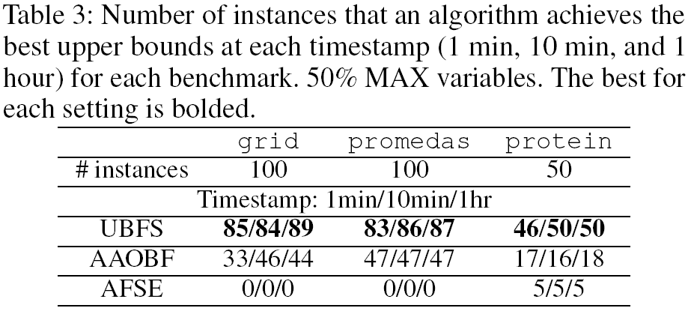
Notes:
This table shows which algorithm achieves the best upper bound at three different timestamps, 1min, 10min, and 1hr respectively. 50% percent of the variables are set to MAX variables. We can see that our UBFS algorithm wins across all the settings by a significant margin.

Slide 13
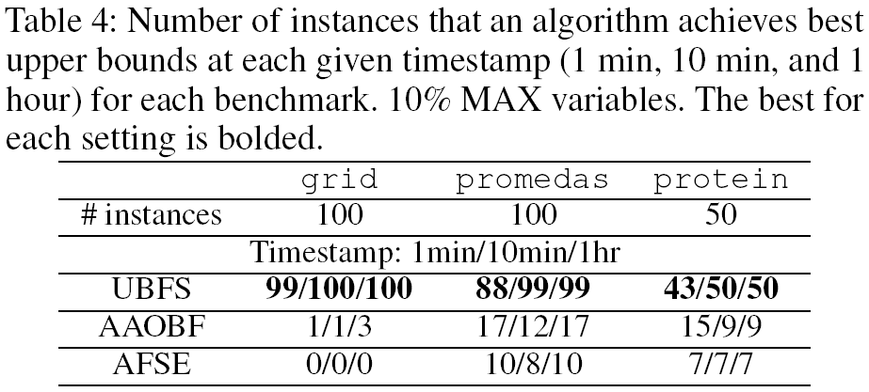
Notes:
Now if we lower down the percentage of MAX variables from 50% to 10%, the internal summation problems tend to get harder. In such case, our algorithm gains more advantage by avoiding some unnecessary exact evaluation of internal summation problems as expected.

Slide 14
Summary
Propose an anytime anyspace search algorithm that provides upper bounds for Marginal MAP
  casts max- and sum- inference into one best-first search framework.
    tracks current most promising partial MAP configuration
    expands the frontier node that contributes most to the upper bound of that partial MAP configuration
    leads to quick reduction on the global upper bound.
  avoids some unnecessary exact evaluation of conditional summation problems
    has significant advantage especially on those instances with hard internal summation problems
Notes:
To summarize, we propose an anytime anyspace search algorithm that provides upper bounds for Marginal MAP, which unifies the max- and sum- inference in one single best-first search framework. Our algorithm can potentially solve fewer summation problems to certify the optimal MAP configuration, and thus has a significant advantage especially on those instances with hard internal summation problems as demonstrated by the experiments.

Slide 15
Thank You!
Q&A

